Slide 1
MIXED REALITY
Human enhancement
Prof. Mariolino De Cecco, Ing. Alessandro Luchetti
Email: mariolino.dececco@unitn.it , alessandro.luchetti@unitn.it
Laboratory website: http://www.miro.ing.unitn.it/

Slide 2
What is the Mixed Reality?
Paul Milgram and Fumio Kishino in 1994 define Mixed Reality (MR) as
“… a particular subclass of VR related technologies that involve the merging of real and virtual worlds.”

Slide 3
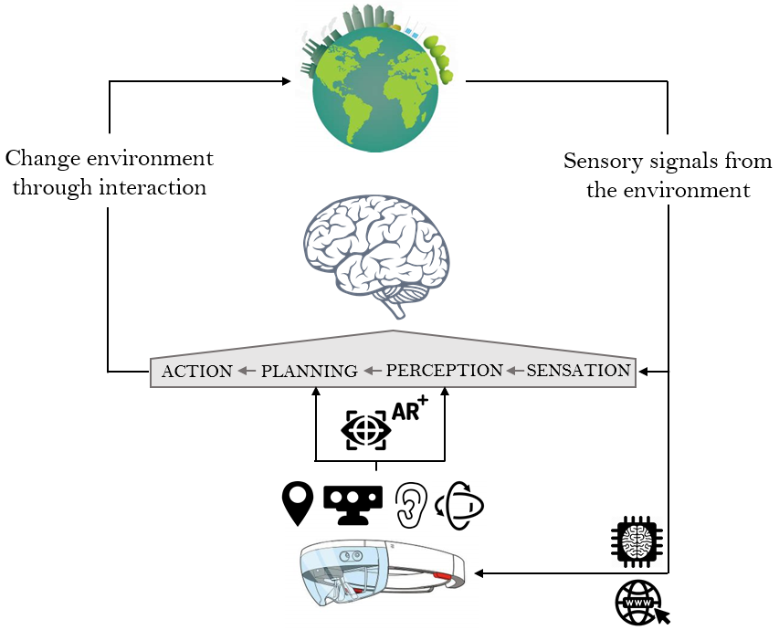
Why is it so important?
By adding virtual and measured cues to real assets or, vice versa, real information within virtual environments enable the augmentation of human capabilities that interact with a much richer information set.
Augmented Reality (AR): Usually reality call for a real-time engine able to elaborate information to feed back to a human agent operating in this context.
Augmented Virtuality (AV): . Those real cues can be, in most of the applications, elaborated offline. In the virtual domain real features regarding other human beings can be filtered, thus leading to privacy friendly applications.
Example of Augmented Reality (AR) loop

Slide 4
Mixed Reality to enhance human capabilities
The Pattern of neuropsychological functions comprises:
7. Motion
2. Attention
6. Visual perception
4. Executive functions
3. Memory
1. Orientation
5. Language
How can MR enhance these functions?

Slide 5
MACRO FUNCTION: 1. Orientation
Possible enhancement with MR:
Using AR, it is possible to combine environmental data (via local maps, other users annotated information, etc) with user location (via GPS) with path planning to show to a user the way to follow in real time.
Several kind of stimuli can be fed back following the proper timeline.

Slide 6
An example is the new AR tool in Google Maps.
Using AR, it is possible to combine street view data with GPS position and your phone's camera to determine exactly where you are and what direction you are facing.
https://www.digitaltrends.com/mobile/how-to-use-ar-mode-google-maps/

Slide 7
MACRO FUNCTION: 2. Attention
Possible enhancement with MR:
MR can provide specific stimuli to trigger a proper reaction in time.
As an example, in assistive guidance systems for intelligent vehicles, a ToF (Time of Flight camera) is able to sense the presence of pedestrians crossing the road.
MR is then used via haptic feedbacks on the acceleration pedal.

Slide 8
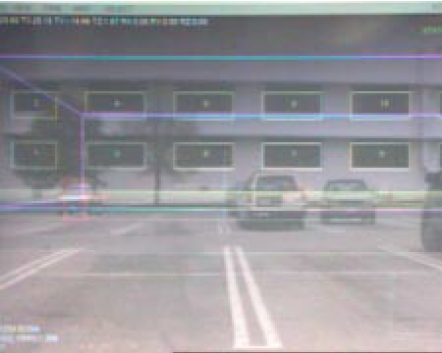
MR can augment selective/divided attention (if more than one target per scenario) by highlighting in the human field of view the targets of interest by means of object recognition system.
As an example, in battlefield scenario thermal cameras are able to identify possible targets while AR can highlight the corresponding field of view.
In the BARS system [Julier 2004] the fighter’s perception is enhanced by superimposing an augmented view of buildings that include wireframe planimetry of its interior, icons to represent reported locations of snipers, the names of adjacent streets, etc.
Image captured from a see-through augmented reality system. Various computer-generated annotations are overlaid directly on objects in the user’s environment.
In general, division of attentive resources can be easily achieved via multitasking software architectures while MR can switch human attention by haptic feedback/visual cues/animation etc.

Slide 9
MACRO FUNCTION: 3. Memory
Possible enhancement with MR:
WM can be improved via step-by-step textual information or visual cues that exploit, for example, spatially aligned animations.
As an example, in assistive systems for Ambient Assisted Living AAL scenario, solutions could use projectors to show suggestions through animations while verifying/synchronizing with the human actual behavior [D'Agostini 2018]

Slide 10
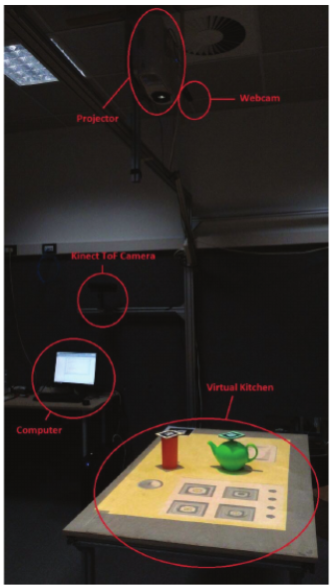
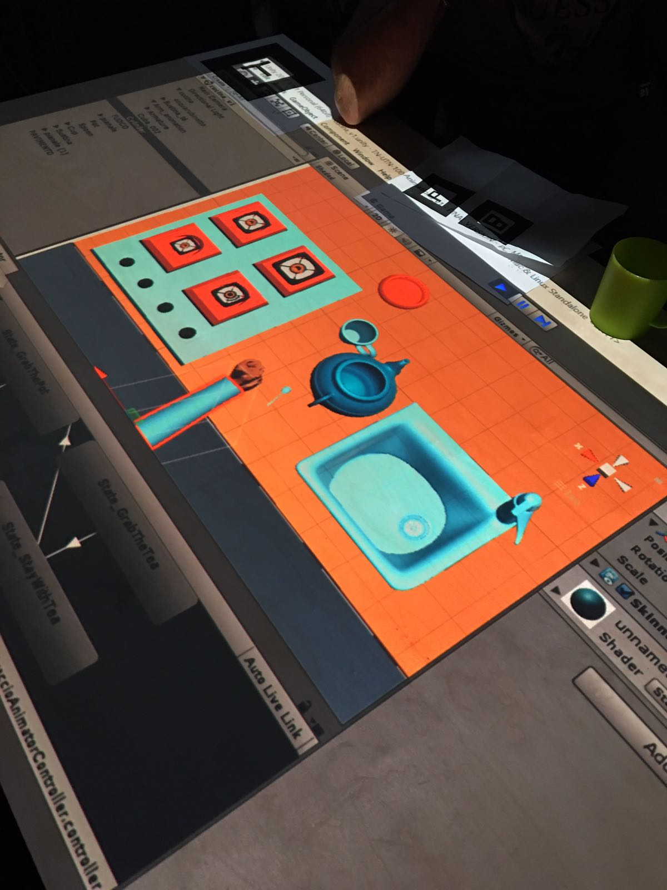
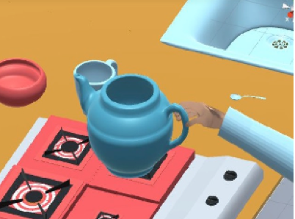
Virtual Environment animation
http://www.miro.ing.unitn.it/index.php/didactics/31-didattica-robotic-perception-and-action/275-courseproject2017
Projected environment that simulates a kitchen

Slide 11
Possible enhancement with MR:
MLT can be improved having the possibility to recall whichever information stored in modern databases or annotations left by other users.
As an example, in industrial maintenance with AR, it is possible to send a low experienced technician to repair complex systems. The technician can benefit from online manuals that retrieve contextualized information on demand, or can be connected in a conferencing system with remote experts, etc.
Again, in the BARS system [Julier 2000] the fighter’s situation awareness is enhanced by retrieving augmented view of buildings via wireframe planimetry, locations of snipers, names of adjacent streets (that can be dynamically annotated by other agents), etc.

Slide 12
MACRO FUNCTION: 4. Executive functions
Possible enhancement with MR:
VR can be used to evaluate person’s ability to carry out tasks that depend on executive functions and offer the opportunity to train such functions in virtual reality in a safety way through the use of serious games.

Slide 13
MACRO FUNCTION: 5. Language
Possible enhancement with MR:
Both verbal production and oral comprehension can benefit from the current technologies of “text to speech with natural sounding voices” and “automatic speech recognition & translation online”.
There are examples of online avatars able to reproduce input text (https://www.ttsdemo.com/)
There are speech to speech translation engines derived from decades of research in speech-recognition, automatic-translation, and machine-learning technologies.
Skype Translator is an example, see a live demo at: https://www.youtube.com/watch?v=cJIILew6l28
Speech production and translation can be used in MR to overcome language barriers

Slide 14
MACRO FUNCTION: 6. Visual perception
Possible human enhance with MR:
Human visual perception is limited to the visible light. This can be a limitation in certain scenarios e.g. firefighting, i.e. smoky views during a fire or occluded, foggy, cloudy.
Fortunately, visual perception can be improved by using high sensitivity cameras or multispectral imaging fed to a human operator via MR technologies (AR or virtual reality glasses, projectors, tablets etc).
For example, in a recent paper [Abdelrahman 2017], it is shown the potential of augmenting visual sensing of firefighters using depth and thermal imaging.

Slide 15
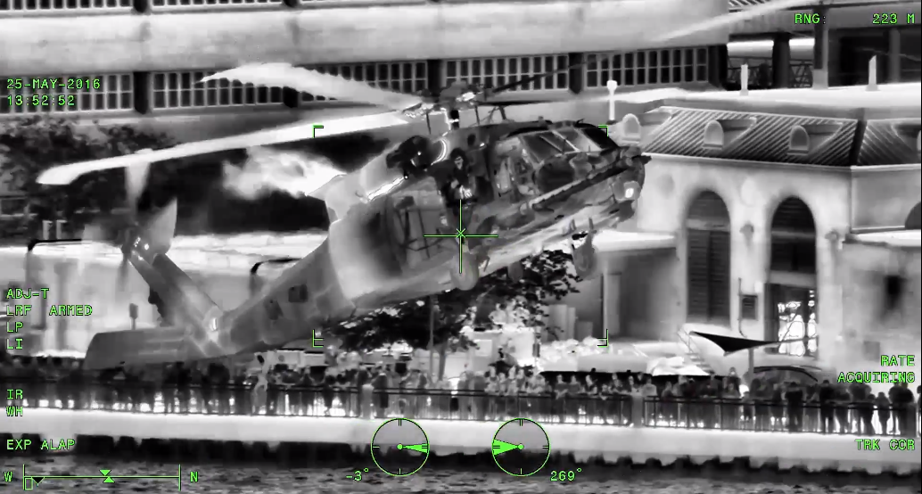
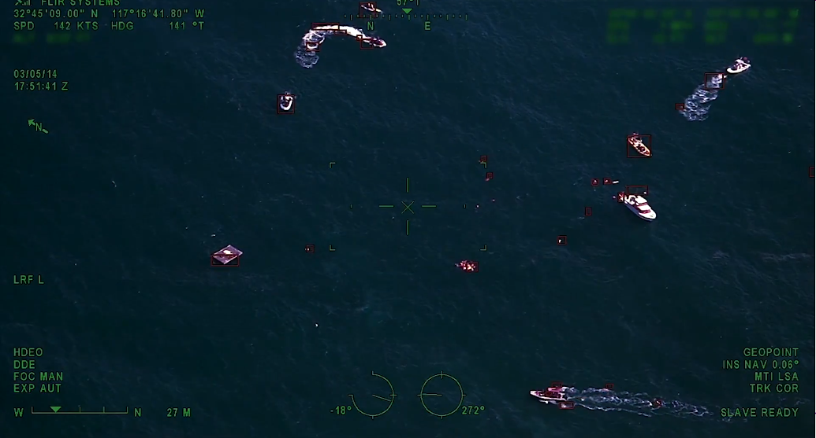
Military or maritime vision is another example.
FLIR commercialises a combination of a thermal sensor and a colour camera with gyroscopic stabilization for stable vision in unfavourable sea conditions.
https://www.flir.it/products/m400/
Furthermore, 3D vision can be used to improve objects recognition in combination with MR (Microsoft Hololens integrates both).
SLAM can be used to map a surrounding space and provide in real time geometric info about it (Microsoft Hololens integrates also dense SLAM to locate the user viewpoint wrt the environment).
Images acquired with FLIR M400

Slide 16
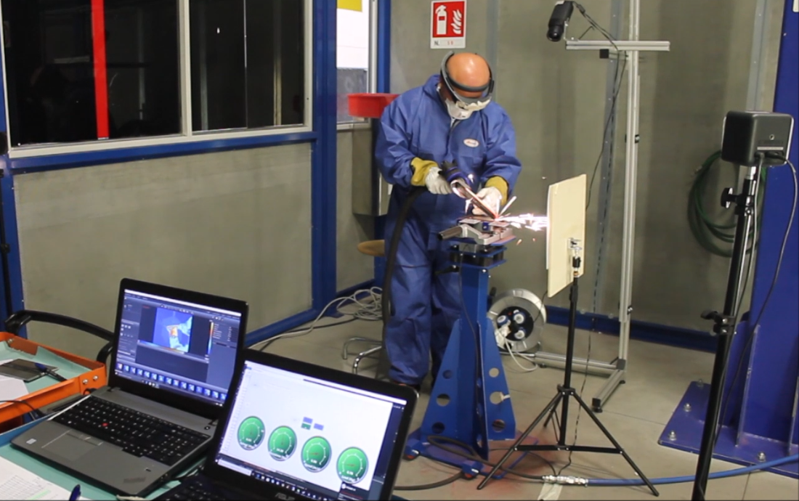
MACRO FUNCTION: 7. Motion
Possible enhancement with MR:
MR is able to enhance human motor behaviour by feeding in real time the output of a motion capture system.
As an example, it can be reported an AR system for industrial grinding process helping the operator to comply working tolerances with a repeatability comparable to that of an automatic system [Luchetti 2019].
http://www.miro.ing.unitn.it/index.php/measurement-a-instrumentation/352-augmented-reality
Experimental acquisition system

Slide 17
References:
S. Allouche, J. Gayon, M. Marzano, and J. Goffette, Inquiring into Human Enhancement: Interdisciplinary and International Perspectives. Springer, 2015.
J. D'Agostini, …, M. De Cecco et all, An Augmented Reality virtual assistant to help mild cognitive impaired users in cooking, Workshop on Metrology for Industry 4.0 and IoT, 2018.
Y. Abdelrahman, P. Knierim, P. Woźniak, N. Henze, A. Schmidt, “See through the fire: evaluating the augmentation of visual perception of firefighters using depth and thermal cameras”, Proc of the ACM International Joint Conference, pp 693-696, Maui, Hawaii — September 11 - 15, 2017.
A. Luchetti, P. Tomasin, A. Fornaser, P. Tallarico, P. Bosetti, M. De Cecco, “The Human Being at the Center of Smart Factories Thanks to Augmented Reality”, IEEE 5th International Forum on Research and Technology for Society and Industry - RTSI, 2019.
S. Julier, Y. Baillot, M. Lanzagorta, D. Brown, L. Rosenblum “BARS: Battlefield Augmented Reality System”, NATO Symposium on Information Processing Techniques for Military Systems, 2000.

